Slide 1


PPT Working Group: Automation
Joint Archipelagic and Pelagic Plan Team Meeting
May 15, 2024

Slide 2
Background
Plan Team work item from May 2023: Form a working group to determine the feasibility of and opportunities for implementing automation in the annual SAFE report update process, including for updating the Council’s online portal for the annual SAFE reports. This working group will also determine an appropriate manner by which longer time series of fishery performance data can be incorporated.
Members: Phoebe Woodworth-Jefcoats, Lynn Rassel, Melissa Snover, Jenny Suter, Thomas Remington, Council Staff

Slide 3
Initial Discussions
Automating the updates for the annual reports will be an iterative, long-term process.
Other regions have successfully implemented automation of various reports.
  e.g., State of the Ecosystem reports from NEFSC, PFMC SAFE
Upside to having data warehouse from which all required information can be downloaded for annual updates.
  Long-term goal, as our current data are housed in many different repositories.
Human input will still be required to perform QA/QC and explain data outputs.
SAFE reports may need to be overhauled to focus on key components that can be automated.
  Evaluate what is required, what is advantageous, and what is perhaps not necessary to be in the SAFE reports (i.e., according to regulations, FEP provisions, and Biological Opinions etc.)
Working group members decided to create flow charts of current processes for data summarization and incorporation into the annual reports to better identify steps that can be automated.
  Want to understand the current state of how the reports are manually updated to determine what’s simple or difficult to automate.

Slide 4
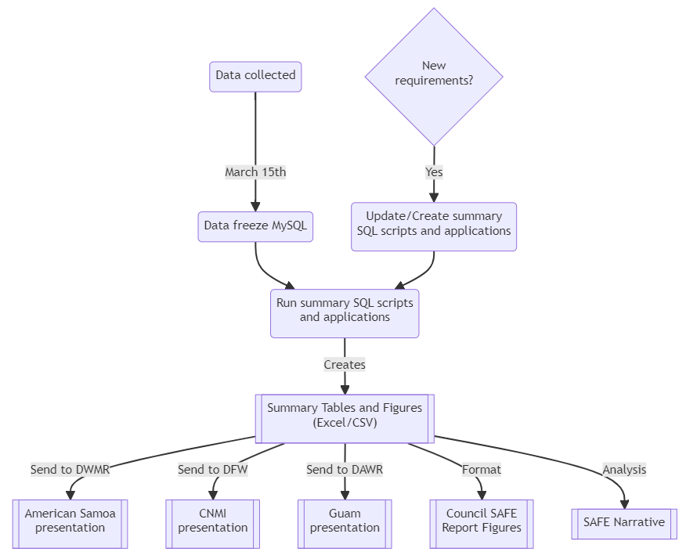
Fishery Performance Data Flow Chart
Territory Pelagic Fishery Performance Modules
Mention how parts of the process are already automated internally by WPacFIN, lots of modernization projects, building new data warehouses, etc.
Commercial data aspect already automated
Notes:
Territorial Pelagic Fishery Performance
SQL scripts and applications are both listed because some outputs are generated through just SQL and other (figures) are generated through SQL scripts and a custom application.
WPacFIN is currently updating data collection systems which will change how we freeze and summarize data. Changes to source data structures will affect any downstream processing.

Slide 5
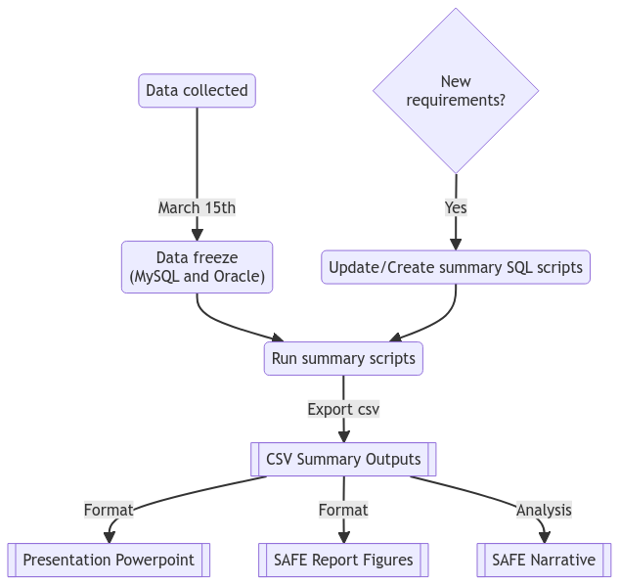
Fishery Performance Data Flow Chart
Hawaii Pelagic Fishery Performance Module
Data summarization is semi-automated through SQL scripts
Figures formatted in Excel
Notes:
Hawaii Pelagic Fishery Performance
Russ compiles the presentation and SAFE report figures for the Hawaii module
Fun fact!
Speaking of automation, the flow diagrams were generated automatically using Mermaid Live Editor from input text.

Slide 6
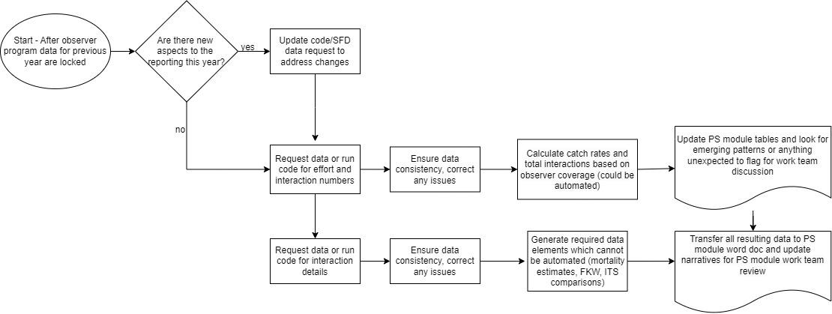
Protected Species Data Flow Chart
Notes:
Many mortality estimates for ITS comparison cannot be automated (Ryder)
Certain ITS comparison tables would be more difficult to automate than others (e.g. sea turtles and IFKW)
The pulling data directly path with data QC allows for annual database element assessment and corrections if identified. (this involves pulling same data from different views and tables where possible for a consistency comparison.)
Some data manipulation beyond the initial data pulls is required for some elements.
A large portion of this module’s workflow includes significant review by a team of experts that weigh in on resulting data in updated tables (not shown in flow chart above). Automation for table updates on the front end would save managers time. Work team discussion however is valuable both as a forum for new information sharing and discussion of evolving trends and it should not be a goal to automate.
This section is also always evolving to include new reporting requirements to streamline or eliminate repetitive work and decrease admin burden.

Slide 7



Oceanic and
Climate Indicators
Flow Chart
Start
Download publicly available data
Append year to file name
Update year in code
Are there new aspects to the indicator this year?
Run code
Yes
Edit descriptive text
No
Coded in R using Quarto
Code generates:
  Formatted text in a Word doc
  All figures
  All data for portal and dashboard
Publicly accessible on GitHub
  Easy collaboration
  Allows replication and error checking
Rerun code
Paste code output into chapter Word doc
Push changes to GitHub
End

Slide 8
Examples of Automation from Other Regions
SAFE Reports from AFSC
ESRs from NWFSC
State of the Ecosystem Reports from NEFSC:
  GitHub + R data package + Technical Documentation → State of the Ecosystem Report pdf (including summary frontmatter made by graphic designer)
PFMC/PSMFC SAFE Reports Apex
  Highly Migratory Species
NPFMC/PSMFC (AKFIN) Reports
  Allocation Reviews
  Groundfish Economics SAFE
  Human Dimensions Data Explorer

Slide 9
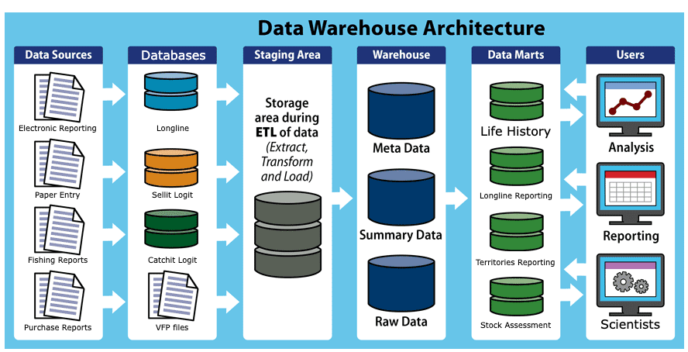
Data Warehouse & Automation

Slide 10
How Do We Go About Automation?
Need to explore platforms that facilitate data informing report templates or API/website
  Replicable workflows?
  Templates or code packages?
Comparable platforms exist in West Coast and Alaska data reporting systems; others?
  Common reporting systems?
  Data infrastructure?

Slide 11
Next Steps
Identify low-hanging fruit for automation – what can we do now/soon?
  Inquiring with section authors about what parts of their reporting processes can be automated
  Determining if the reports can exist in a format other than Word/PDF files – something more easily linked to databases
  Replacing copy-and-paste with code-based approaches
  Utilizing existing code for current data summaries and linking it to a more comprehensive automation system
  Replicating success stories, e.g., RFMO automation and automated reporting from other regions
Implementing automation
  Working directly with section authors
  NOAA Fisheries Open Science: reproducible, transparent, and collaborative workflows
Discussing presenting full time series prior to previous 10 years: Council data portal proposed as a repository
  Consensus? Alternatives?

